Slide 1
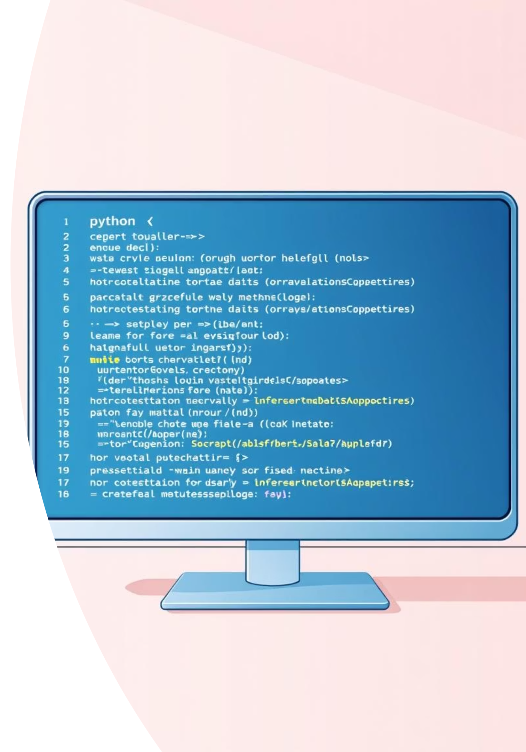
Python Exception Handling & Decorators
Clean, Powerful Error Management

Slide 2





Understanding Python Exceptions
An exception in Python signifies an error that occurs during the execution of a program, disrupting its normal flow. Unlike syntax errors, exceptions are detected at runtime and require specific handling to prevent program crashes.
TypeError
ValueError
ZeroDivisionError
Occurs when an operation is applied to an object of an inappropriate type, such as adding a string to an integer.
Raised when a function receives an argument of the correct type but an inappropriate value, like trying to convert "abc" to an integer.
Triggered when division or modulo by zero is attempted, a common mathematical impossibility.
Python provides robust mechanisms to handle these runtime errors gracefully, ensuring your application remains stable and user-friendly. The primary way to manage exceptions is through the try-except block, which allows you to "catch" errors and execute alternative code.
The Try-Except-Finally Flow
Try
The code that might raise an exception is placed here. It's the "protected" part of your program.
Except
If an exception occurs in the try block, the program jumps here. You can specify which exception to catch.
Else
This block executes if no exceptions occur in the try block, ensuring smooth operation.
Finally
Always executes, regardless of whether an exception occurred or not. Ideal for cleanup operations like closing files.
Practical Example: Handling Division
def safe_divide(a, b): try: result = a / b except ZeroDivisionError: print("Error: Cannot divide by zero!") result = None except TypeError: print("Error: Invalid input types for division!") result = None else: print(f"Division successful. Result: {result}") finally: print("Division attempt complete.") return result safe_divide(10, 2) safe_divide(10, 0) safe_divide("abc", 5)

Slide 3

Python Decorators: Enhancing Functions
Decorators in Python provide a powerful and elegant way to extend or modify the behavior of functions or methods without permanently altering their code. They are essentially functions that take another function as an argument and return a new, enhanced function.
Why Use Decorators?
Code Reusability
Separation of Concerns
Apply common functionalities (like logging, timing, authentication) across multiple functions with minimal effort.
Keep core business logic clean by separating cross-cutting concerns into distinct decorator functions.
Improved Readability
The @decorator_name syntax makes it clear that a function's behavior is being modified, improving code clarity.
Decorator Example:
def decorator_function(original_function): def wrapper_function(): print("Before the function runs") original_function() print("After the function runs") return wrapper_function@decorator_functiondef say_hello(): print("Hello!")say_hello()
Decorators are a powerful feature for writing cleaner, more modular, and maintainable Python code by abstracting common patterns and enhancing functions' capabilities without directly modifying their definitions.

